Slide 1

Lightweight Cryptography
Light
Pascal Lafourcade (LIMOS, France)
Takaaki Mizuki (Tohoku University, Japan)
Atsuki Nagao (Ochanomizu University, Japan)
Kazumasa Shinagawa (Tokyo Tech / AIST, Japan)
Notes:
Thank you for introduction. I’m Kazumasa Shinagawa from Tokyo Tech in Japan. He is Pascal Lafourcade from LIMOS in France. I and Pascal present this talk as a joint presentation. This is the joint work with Takaaki Mizuki and Atsuki Nagao in Japan. The title of this talk is Light Cryptography.

Slide 2
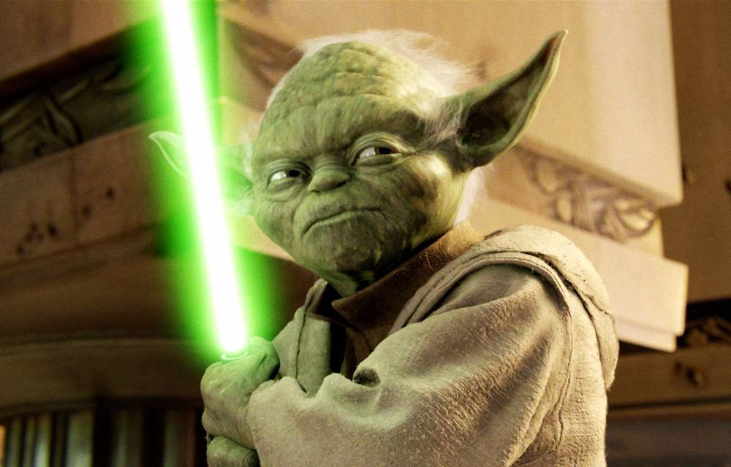

Slide 3



Slide 4
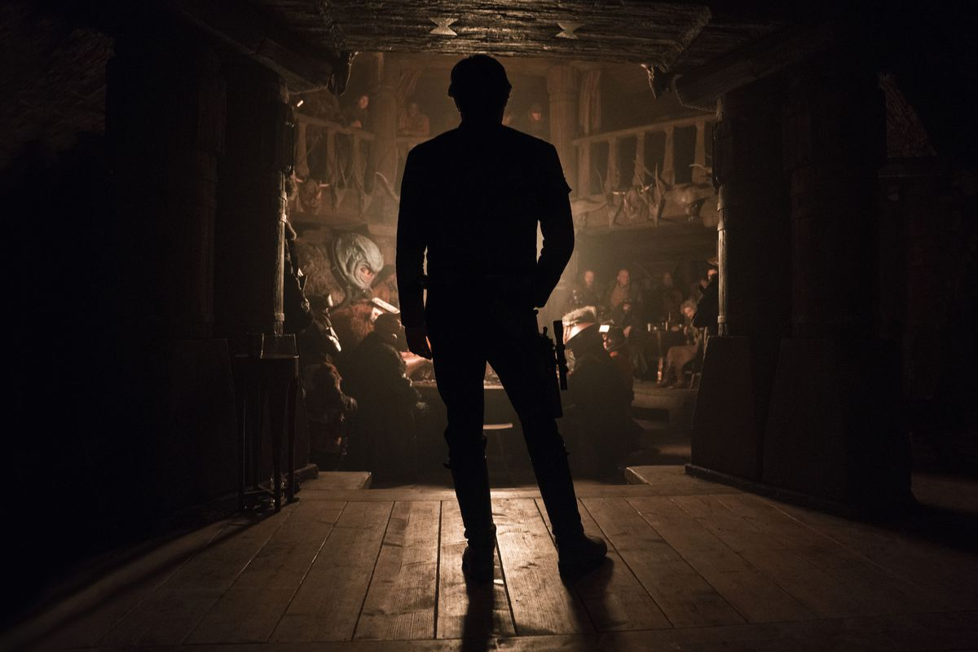

Slide 5


Slide 6
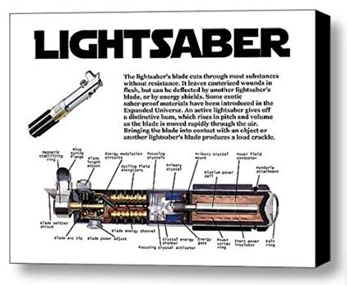

Slide 7
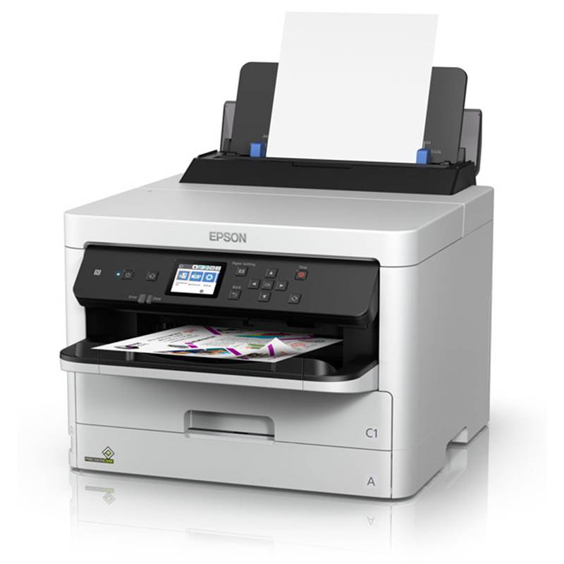
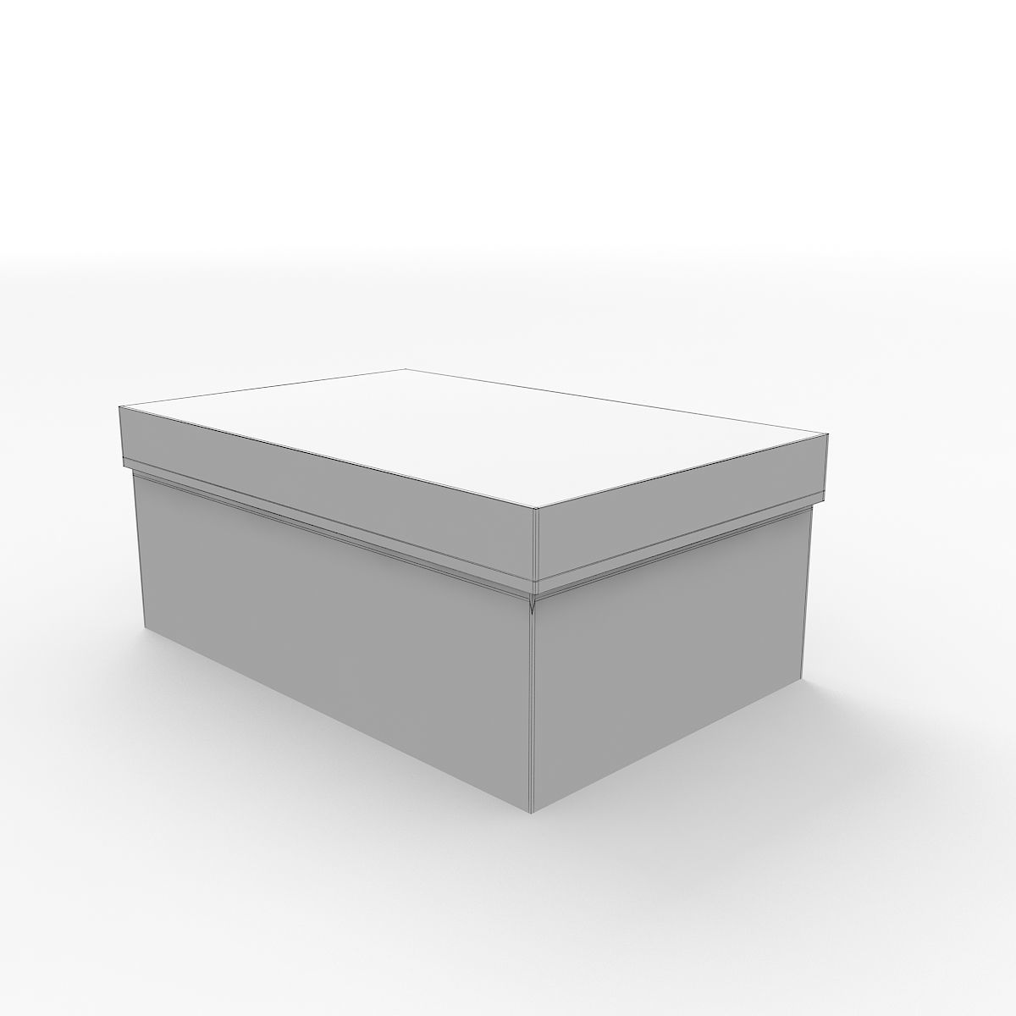
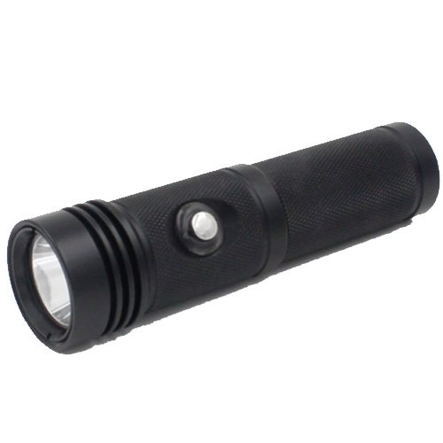
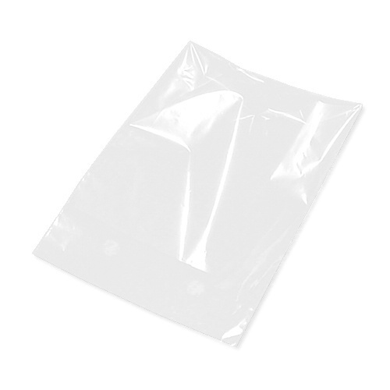
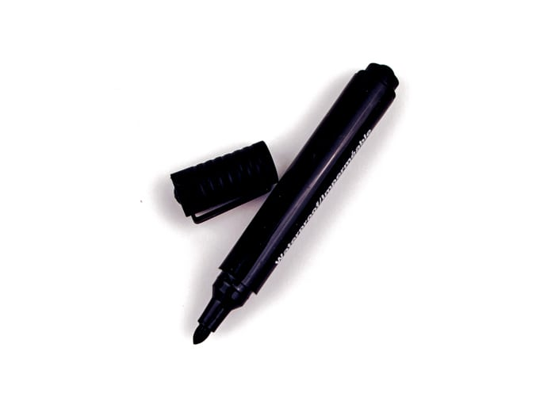
Material

Slide 8
Agenda
Introduction
  Physical cryptography
  Related works
Light cryptography
  Model
  Set-Intersection protocol
  Min/Max protocol
  Addition protocol
Conclusion

Slide 9
Agenda
Introduction
  Physical cryptography
  Related works
Light cryptography
  Model
  Set-Intersection protocol
  Min/Max protocol
  Addition protocol
Conclusion

Slide 10
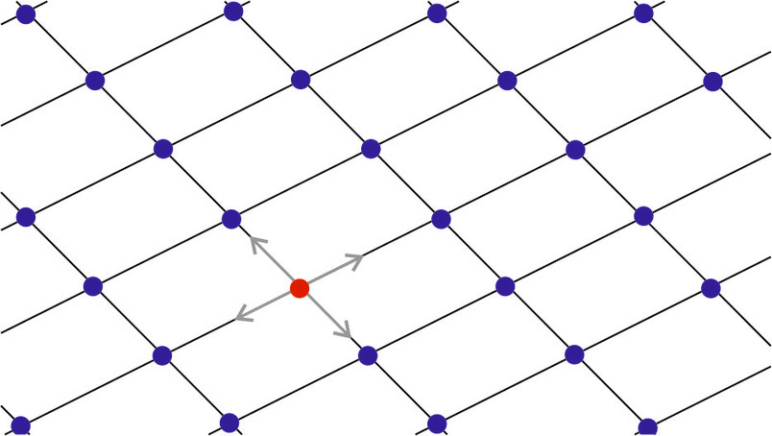
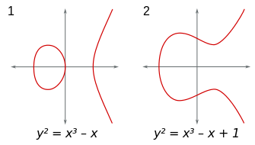
Background
Modern cryptography is more and more used and complex
Teaching cryptography is hard
  Complex algorithm
  Security
  Deep mathematics
  Not visualized
OUR GOAL : a good educational tool for cryptography
Notes:
Modern cryptography is more and more used. However, they are somewhat complex. So, teaching cryptography is sometimes very hard task. At first, cryptographic algorithm tends to be very complex. So, it is hard to follow. Security is also hard to follow because the concept of security is difficult. They are relied on deep mathematics. So, it is need to teach mathematics before teaching cryptography. Moreover, all implementations of cryptography are of course programs inside of computers, so we cannot see actual computation inside of computers.
Our aim is to propose a good educational tool for cryptography that overcomes these difficulties.

Slide 11
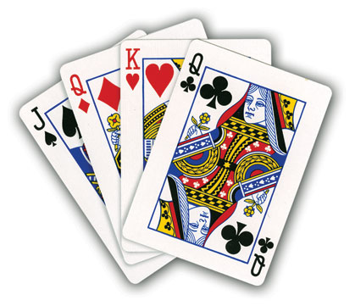
Physical cryptography
Cryptography using physical objects (e.g. playing cards)
Suitable for education
  Good visualization
  Concrete
  Introduction to cryptographic concepts
  No need of mathematics knowledge

Slide 12
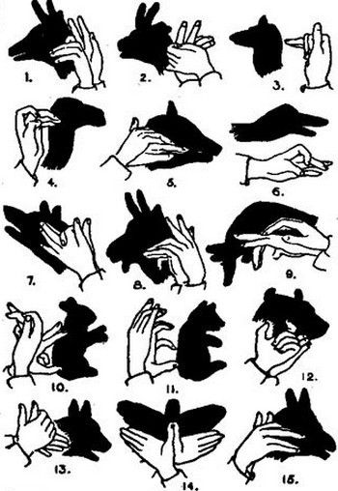
Light cryptography
New model of physical cryptography
  Computation based on light and shadows
  Easy to understand
  Secure

Slide 13
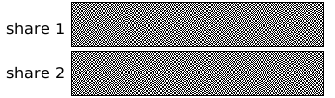
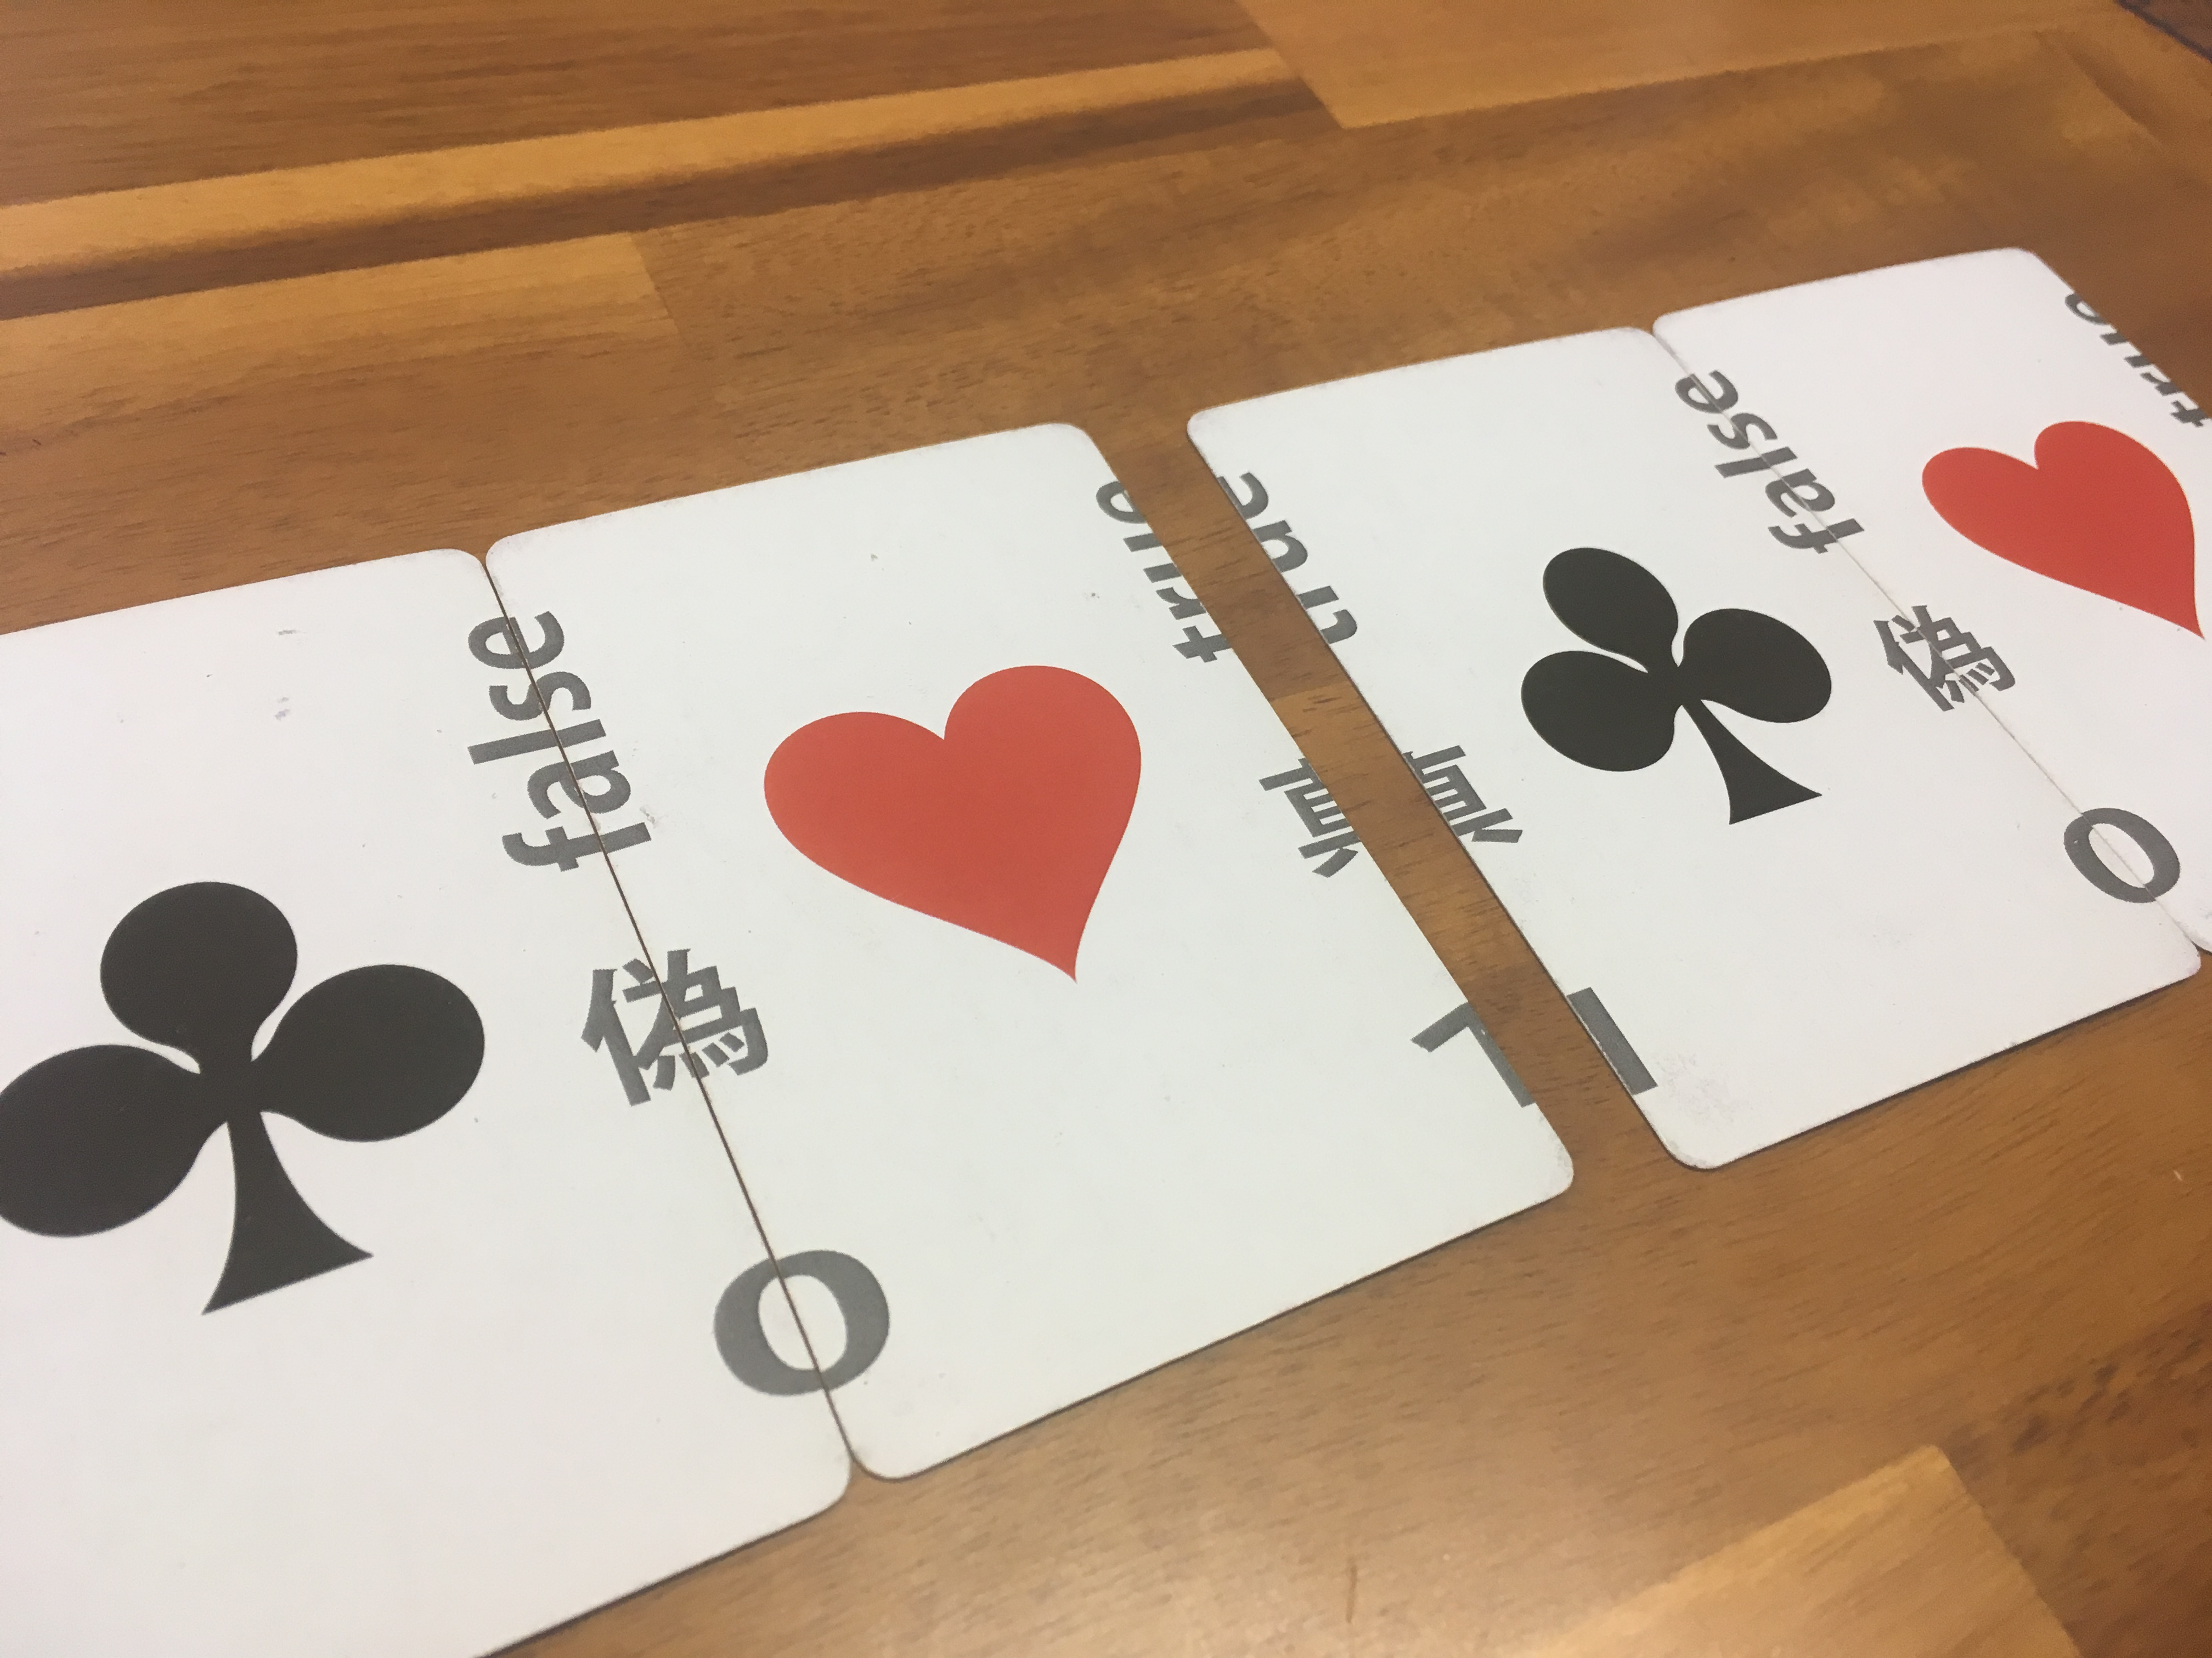
Related works
Zero-knowledge proof for “Where’s Wally” [1]
  Proof that “I know Wally’s position”
  without revealing the position
Visual secret sharing [2]
  Secret image is reconstructed
  by stacking two transparent sheets
Card-based protocols [3]
  Secure computation protocol
  using a deck of cards (like playing cards)
[1] Naor, Naor, and Reingold, “Applied Kid Cryptography or How To Convince Your Children You Are Not Cheating”, EUROCRYPT 1999.
[2] Naor and Shamir, “Visual Cryptography”, EUROCRYPT 1994.
[3] den Boer, “More Efficient Match-Making and Satisfiability The Five Card Trick”, EUROCRYPT 1989.
Notes:
Where's Wally? is a series of children's puzzle books. Readers are challenged to find a character named Wally hidden in illustrations.

Slide 14
Agenda
Introduction
  Physical cryptography
  Related works
Light cryptography
  Model
  Set-Intersection protocol
  Min/Max protocol
  Addition protocol
Conclusion

Slide 15
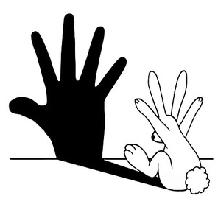
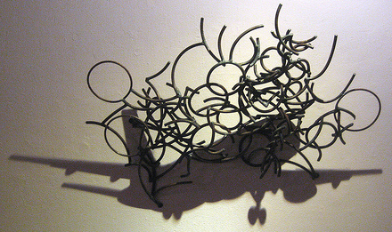
Properties of shadows
It is sometimes hard to imagine its original shape from shadows
Notes:
Light cryptography is secure computation based on the properties of shadows.
Let see the left picture. The shadow looks like a human hand but it is a rabbit.
Let see the right picture. The shadow looks like an airplane but it is a group of wires.
It is sometimes hard to imagine its original shape from shadows.
So, shadows have a kind of onewayness like oneway functions.
We use this property to ensure the security of our protocols.

Slide 16
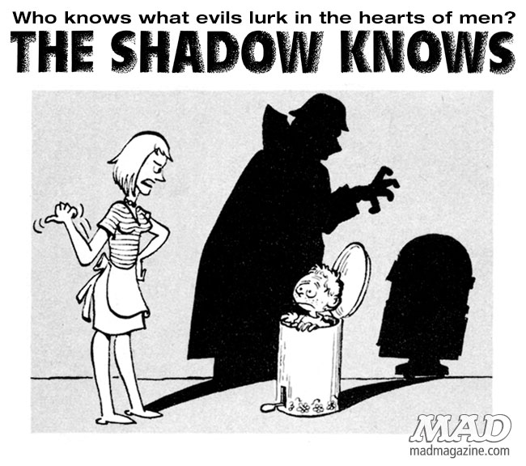

Slide 17
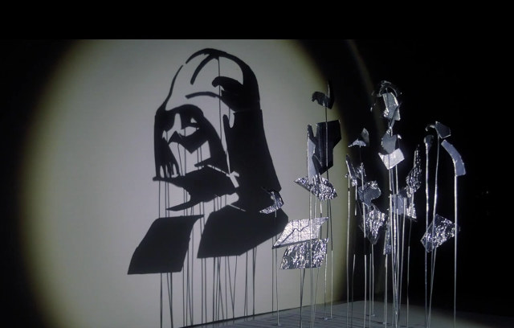

Properties of shadows
The resulting shadow is the union of shadows
Shadow addition
Notes:
From this observation, we also notice that we can define an addition operation for shadows.
For example, if two shadows are overlapped, then the resulting shadow is the union of two shadows.
We call this operation shadow addition. We use this property to compute a function.

Slide 18
Protocols of Light Cryptography
Start: Each party has a secret input x_{i}
Goal: Compute a joint function f(x₁, x₂, …, x_{n}) with hiding secrets
Each party has an input sheet
Depending on own input, each party makes holes in the sheet
hole
Step 2
Input sheet
if x_{i} = 0
if x_{i} = 1

Slide 19
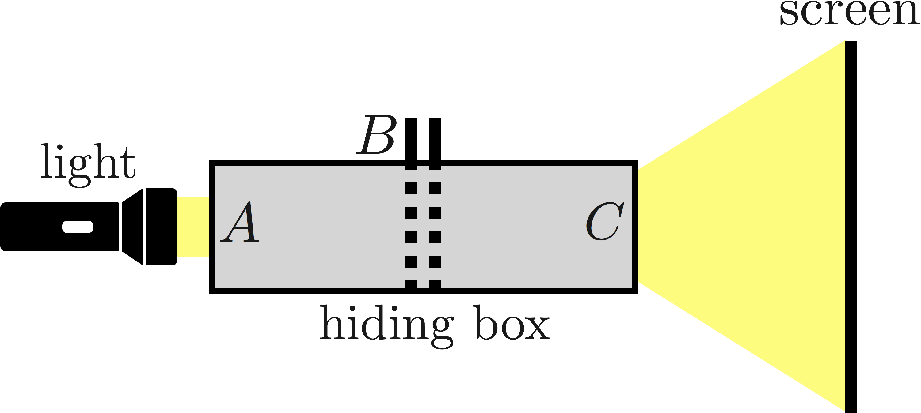
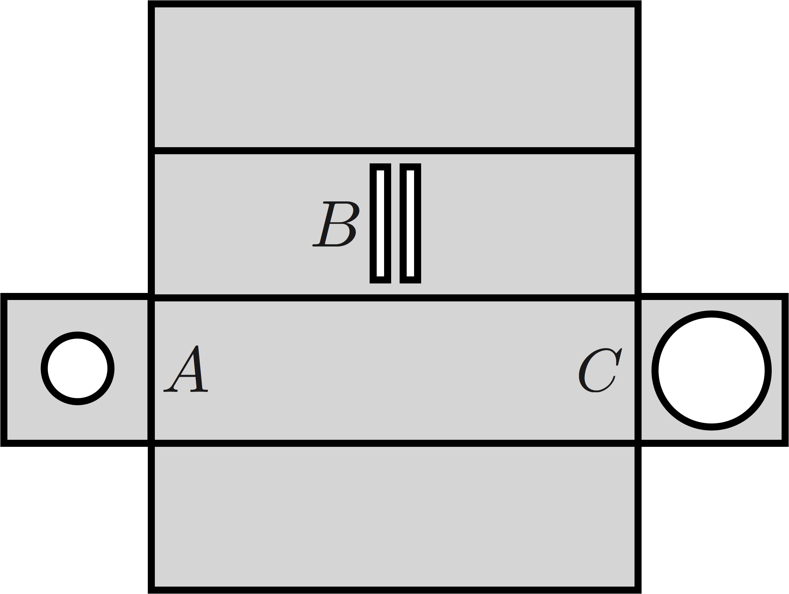
Protocols of Light Cryptography
Each party inserts own input sheet in the hiding box (B)
(A) is illuminating by the light
The result image is printed on the screen
A net of the box

Slide 20
How to “securely” have an agreement
Alice and Bob will go to a date if both wants to go
They want to avoid an “embarrassing” situation
(ex.) Bob wants to go but Alice doesn’t want to
Alice
Bob
Yes
Yes
→ agreement
Determine the current situation
without revealing inputs directly
Yes
No
No
Yes
→ disagreement
No
No
if Yes
if No

Slide 21
How to “securely” have an agreement
Alice and Bob will go to a date if both wants to go
They want to avoid an “embarrassing” situation
(ex.) Bob wants to go but Alice doesn’t want to
Alice
Bob
Yes
Yes
→ agreement
Determine the current situation
without revealing inputs directly
Yes
No
No
Yes
→ disagreement
Computation of an AND
No
No
if Yes
if No

Slide 22
How to “securely” have an agreement
Alice and Bob will go to a date if both wants to go
They want to avoid an “embarrassing” situation
(ex.) Bob wants to go but Alice doesn’t want to
Alice
Bob
Yes
Yes
→ agreement
Determine the current situation
without revealing inputs directly
Yes
No
No
Yes
→ disagreement
Computation of an AND
No
No
NOBODY LEARNS OTHER CHOICE
if Yes
if No

Slide 23

Schedule a meeting for next month?

Slide 24
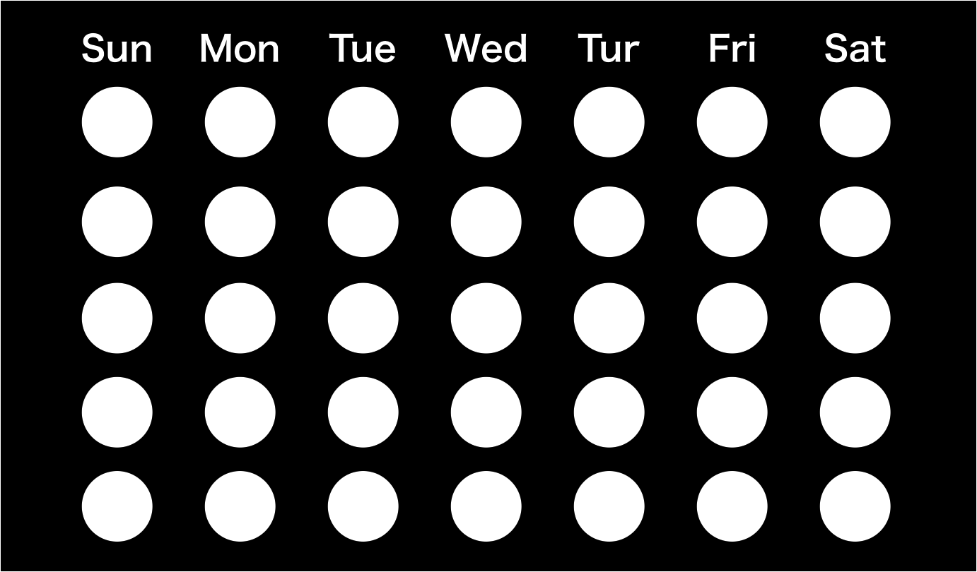
Transparent sheets
Input sheets also can be implemented by transparent sheets
Each party fills it by a black pen or a black-colored seals
transparent
black pen
The black image is printed on transparent sheets
Depending on input, some circles
are filled by a black pen

Slide 25
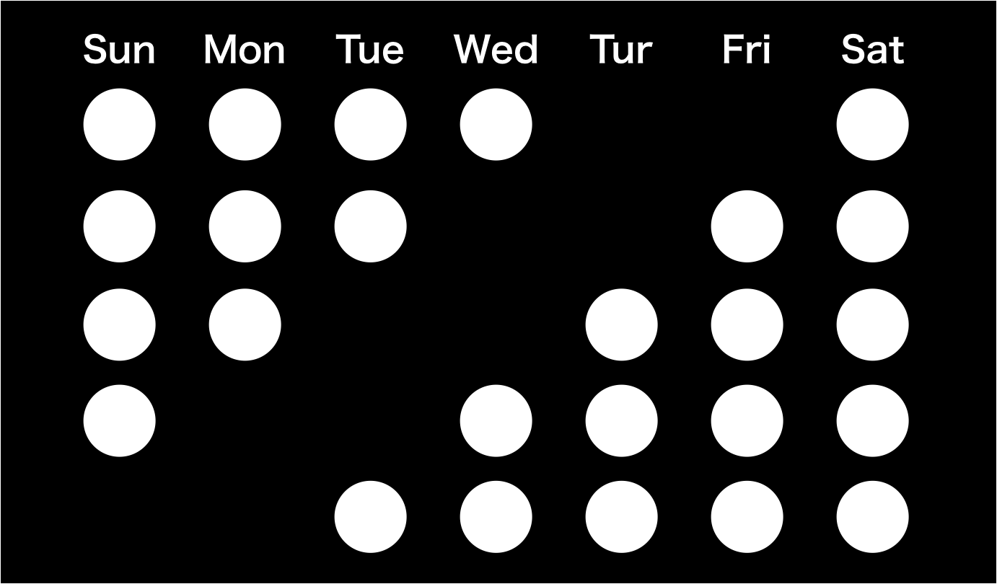
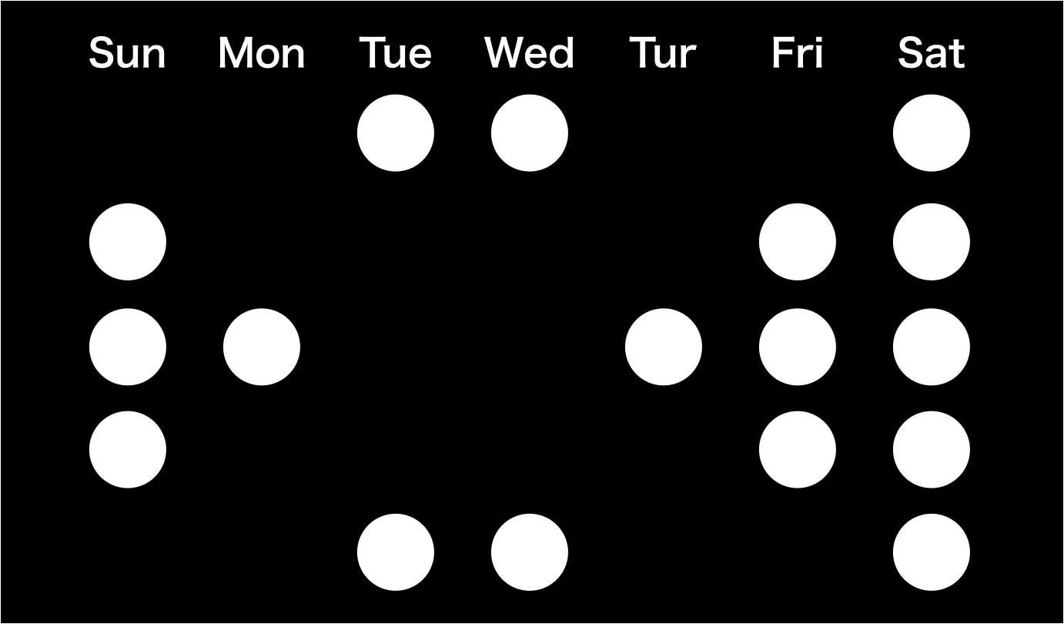
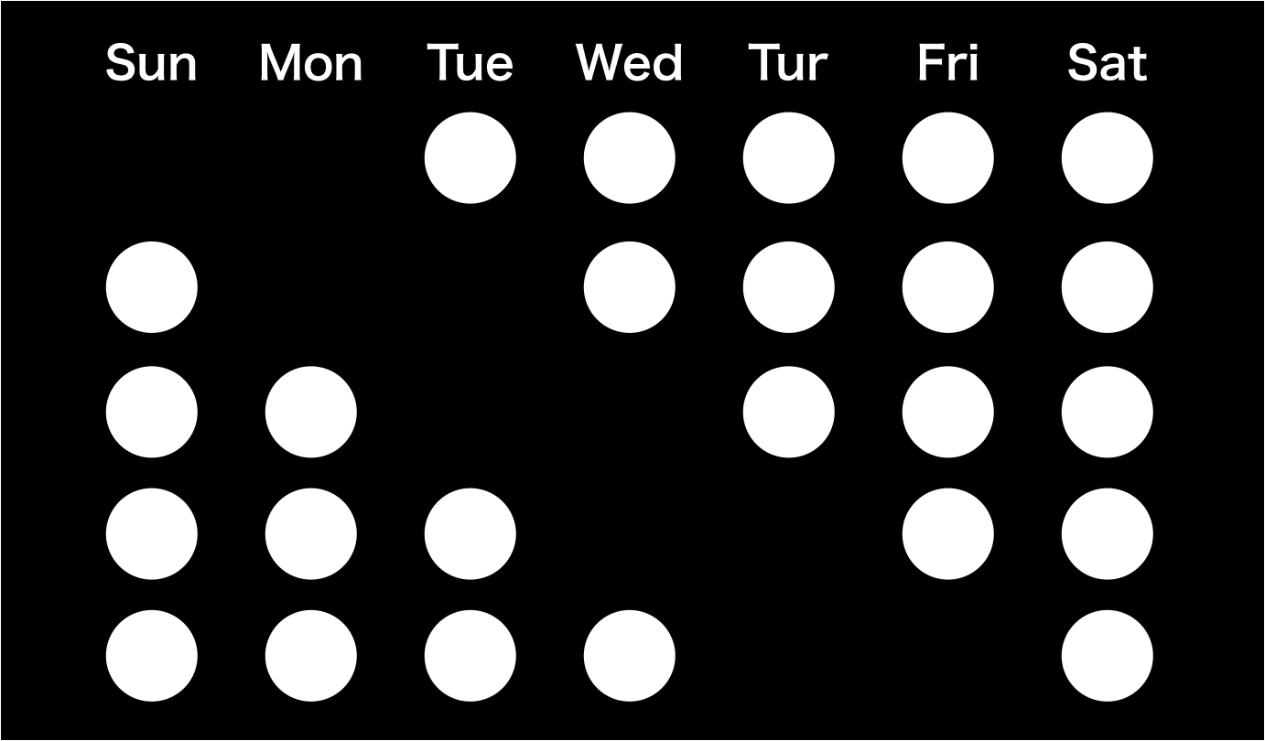
Scheduling (set-intersection)
Input sheet
Alice’s
schedule
result
Bob’s
schedule
NOBODY LEARNS OTHER CHOICE

Slide 26


Compute the maximum of salaries ?

Slide 27



Max protocol
Input sheet
Alice’s
input = 33
Bob’s
input = 16
result = 33
NOBODY LEARNS OTHER CHOICE

Slide 28
Compute the minimum of salaries ?

Slide 29



Min protocol
Input sheet
Alice’s
input = 24
Bob’s
input = 70
result = 24
NOBODY LEARNS OTHER CHOICE

Slide 30
Compute who is the millionaire?

Slide 31
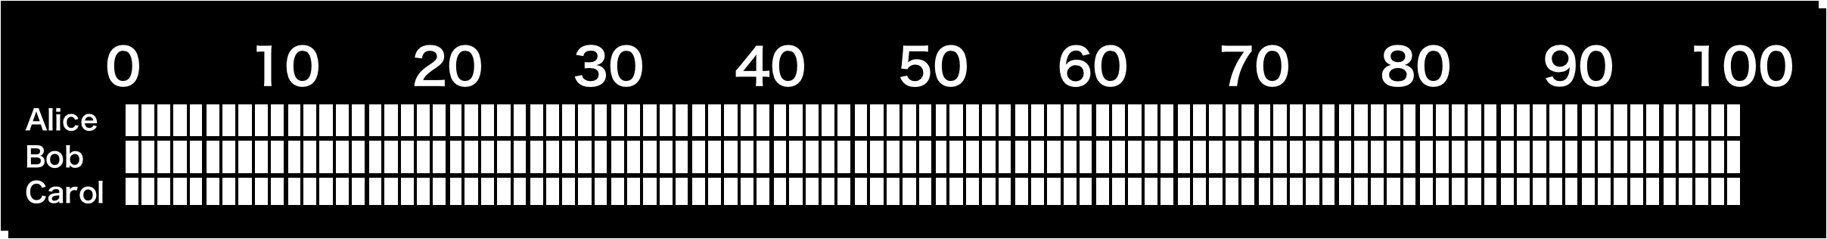
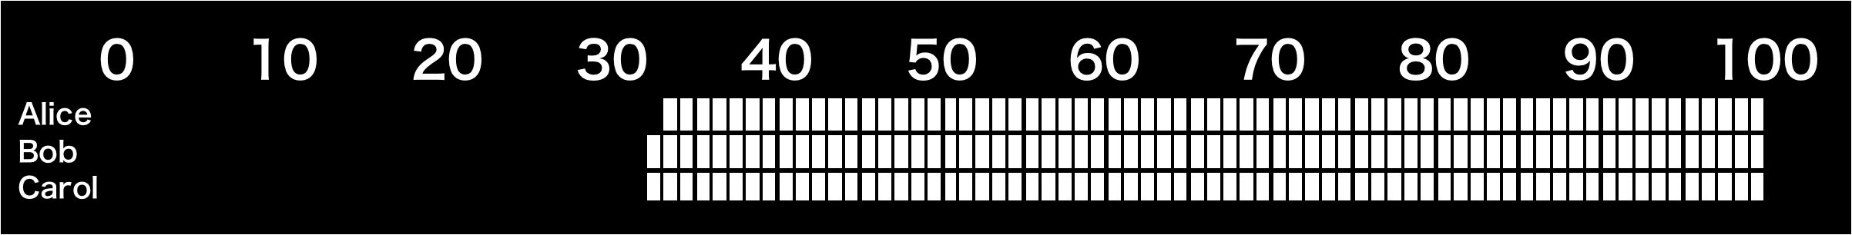
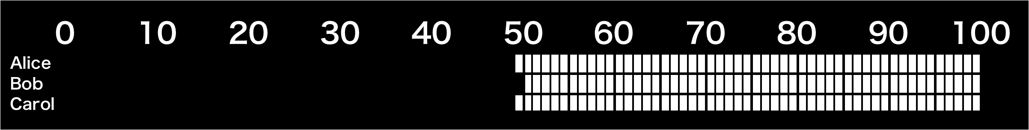
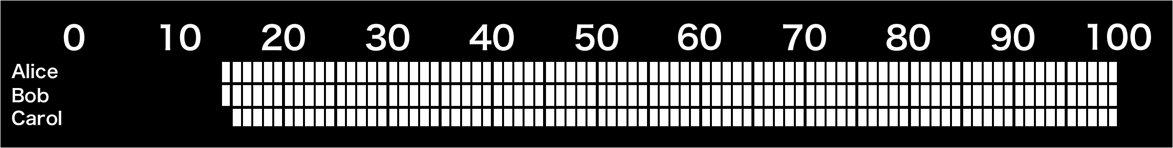
Max with name
Input sheet
Alice’s
input = 33
Bob’s
input = 50
Carol’s
input = 50
NOBODY LEARNS OTHER CHOICE

Slide 32
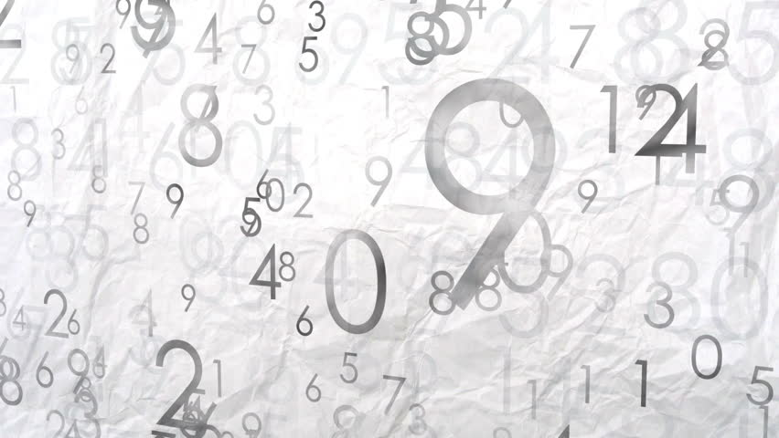
Compute the sum of numbers ?

Slide 33
Addition protocol 0
Input sheet:
Alice’s
input = 1
Bob’s
input = 2
Carol’s
input = 3
The output image is randomized
If two circles are collude, the output is not correct

Slide 34
Addition protocol 1
Input sheet:
Alice’s
input = 1
Bob’s
input = 2
Carol’s
input = 3
The output image is randomized
If two circles are collude, the output is not correct

Slide 35
Addition protocol 2
Input sheet:
Alice’s
input = 1
Bob’s
input = 2
Carol’s
input = 3
Use instead of
The collision probability is reduced

Slide 36
Conclusion
CONTRIBUTIONS:
Light cryptography is a new model of physical cryptography
Secure computation based on light and shadows :
- Max/Minimum
- Addition
- Schedule

Slide 37
Future directions
Use it in cryptography courses
Designe more protocols : Subtraction ? Multiplication ?
Study more about physical cryptography
Test
Design
Feedback

Slide 38

Questions ?

